Slide 1

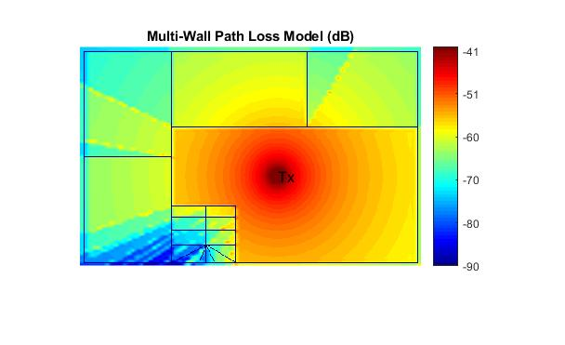
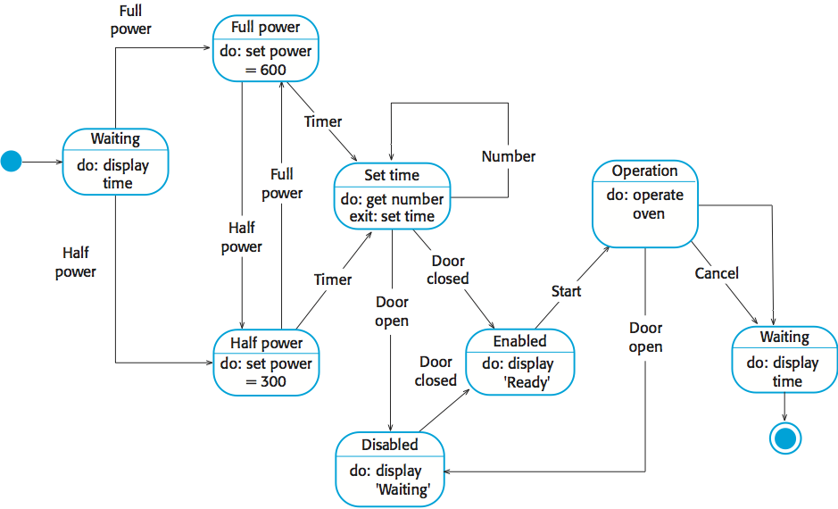
Research: A short summary of your research providing key related works; Be critical. Use appropriate citation.
UFCFXK-30-3: Digital Systems Project
Student name: Simon Llewellyn
Project Title: Optimisation of Wireless Network Access Point Positioning Using Artificial Intelligence
Abstract:
The abstract includes a short description of the project. It should not exceed one paragraph. Ideally, it should summarise the key points of your project including the project idea and scope.
Key requirements:
Provide key requirements with short description if required.
Functional
The tool must blah blah
The tool must blah blah blah
The tool should blah blah blah
The tool should blah blah blah
The tool would blah blah blah
Non-functional
The tool must blah blah blah
The tool must blah blah blah
The tool should blah blah blah
The tool should blah blah blah
The tool would blah blah blah
Implementation artefacts (if any)
Can include other diagrams that verify the implementation process (e.g. class diagram etc.)
or
Aims and objectives:
Objectives
Create a problem space with the aid of a simulator that allows the measure the fitness of a solution.
Compile data from previous method and popular algorithms find areas where these algorithms could be improved.
Study other possible optimisation algorithms.
Aims
Create an algorithm that will find the optimal placement for wireless APs with a set area.
Solutions will taking into consideration the simulated environment obstacle e.g. walls
Gain the highest signal coverage across the problem space with the minimal amount of AP’s used.
The algorithm should also be able to scale with the same degree of accuracy ideally with minimal trade off in computational time.
Design and implementation
Planning and Management: This section will include your planning and management.
State Diagram
References: References and citations should be in UWE Harvard style

